Slide 1
Purchase Card
Notes:
Introduction
Who you are
The Class
What will we do in the class

Slide 2
Purchase Card Guidance and Use
In accordance with CFO 4200.1A,
d. Cardholders.
(5) Obtain prior written authorization from the authorizing official for all purchases;
(7) Ensure the independent receipt and acceptance of goods and services is documented for all purchases over $75;
(8) Obtain written verification of receipt for all supplies or services not delivered and accepted directly by the cardholder
For more information visit:
http://insite.gsa.gov/wps/portal/gsa_insite/purchasing_and_payments/gsa_purchase_card/
Notes:
Your requisition to purchase goods and services
Capture the approvals – Once request is approved you say what you want to purchase
PR goes to contracting officer
PR tells what you want to order and the funding

Slide 3
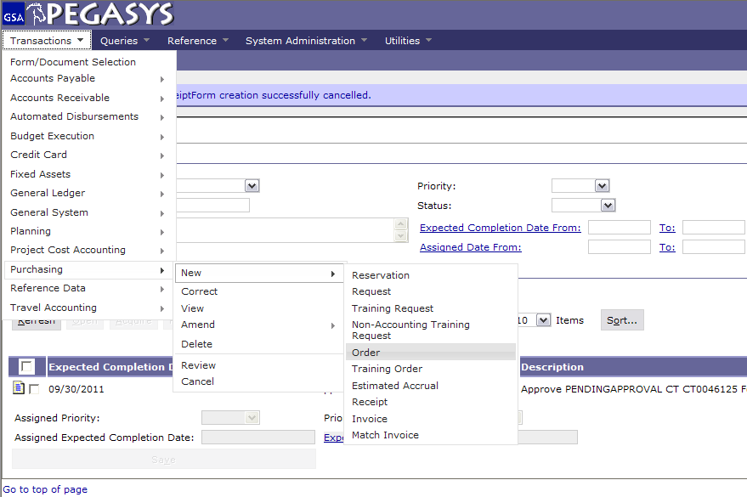
Create a Purchase Card Log
Choose:
  -Transaction
  - Purchasing
  - New
  - Order
Notes:
PR is “Copied Forward” to the GP
Once it is an Order, it is an Obligation. (Undelivered Order)
Once Order-Invoice-Receipt match Pegasys Pays the Vendor- money is no longer GSA’s
If you do not like it or do not want it, do not do a Receipt. Otherwise, Pegasys will pay it

Slide 4
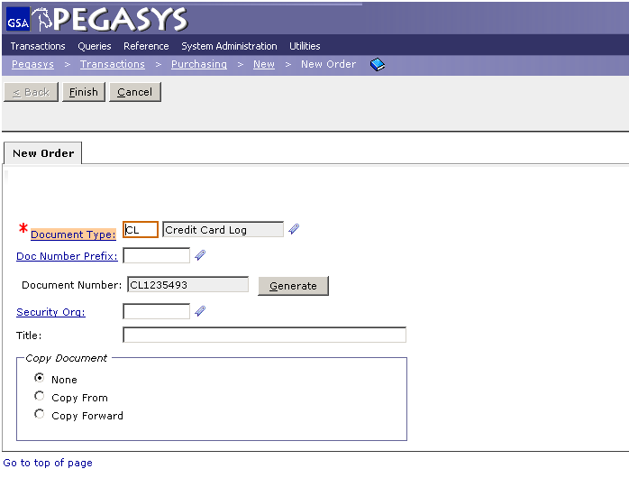
Purchase Card
Enter CL as the Document Type then press the tab key.
Click the Generate button to create Document Number.
Click the Finish button.
Tip: Use this CL Document Number on all of your documents
Notes:
Training Request= TR
Not used very often, usually only for Prepaid Training

Slide 5
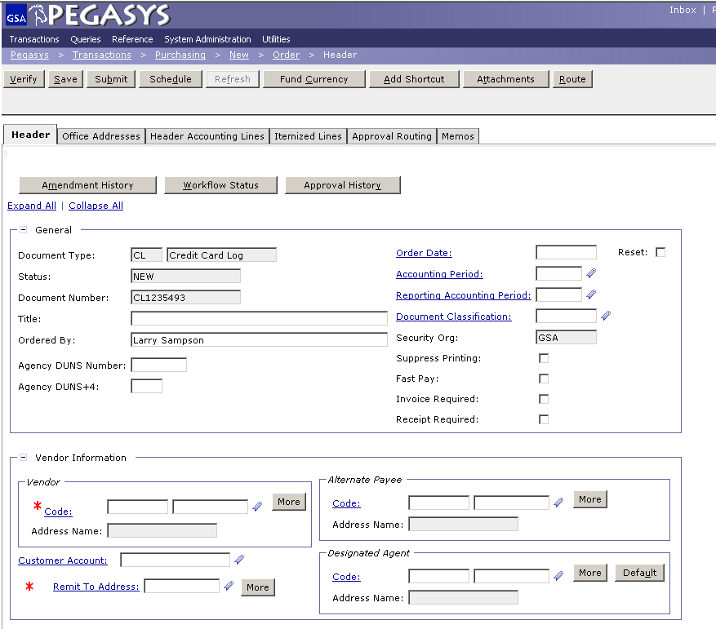
Header Tab
Enter a brief title in the Title field to help make searching later easier
Enter a name in the Ordered By box.
Click the Code link to search for a vendor.
`
`
Notes:
PR is universal across all GSA offices
Document number is composed of the Date and the last four numbers are a sequence

Slide 6
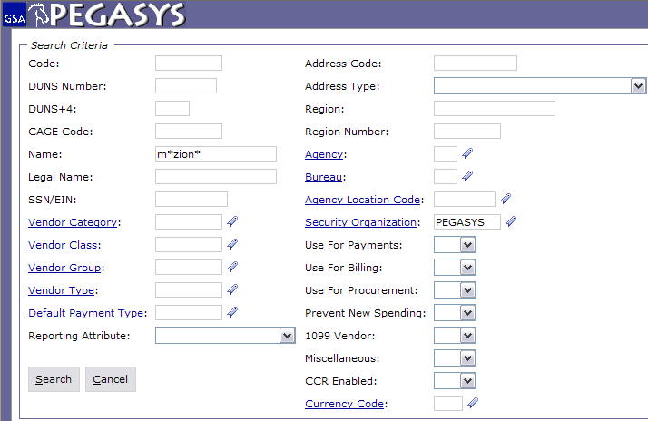
Header Tab - Vendor Code Search
Enter:
Code – Tax Identification Number (TIN)
or
DUNS
or
Name
Enter:
PEGASYS in the Security Org field
The * is a wild card for searching
Notes:
Does not need a vendor (contracting officer researches to find best price)
Title is optional but highly recommended. If you search all of your PR’s whatever you write in Title will be displayed.
Requested by is who wants it, if you’re ordering for the whole office you want to know who it is going to.

Slide 7
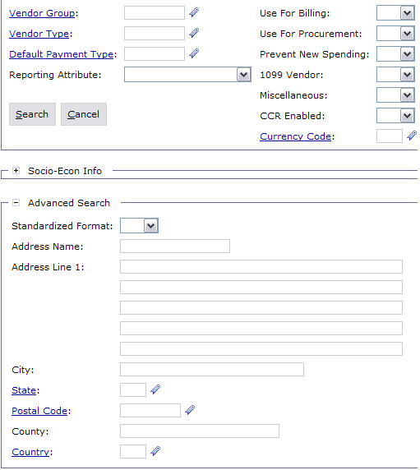
Header Tab – Advanced Search
Enter the City and/or State fields to narrow the search
Click Search
Notes:
Description is displayed on the Transaction Summary Report

Slide 8
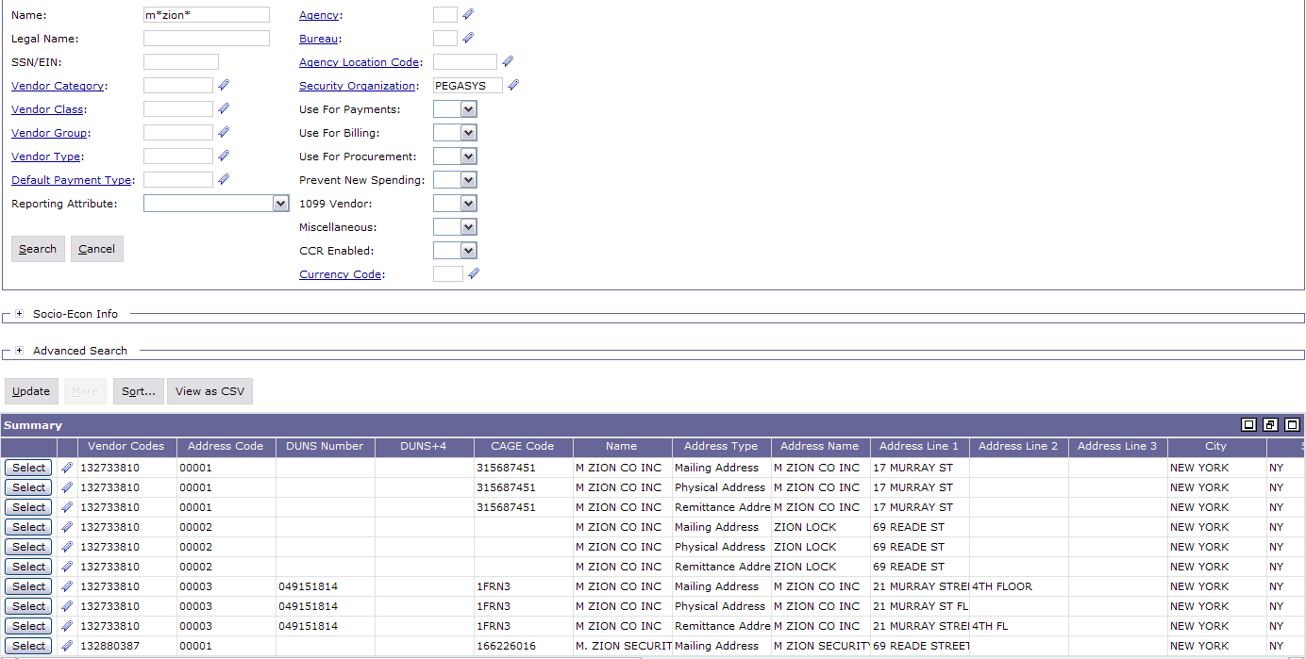
Header Tab – Search Results
Click Favorites Icon
Select Vendor
https://finance3.gsa.gov/

Slide 9
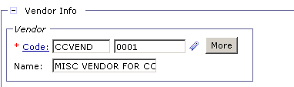
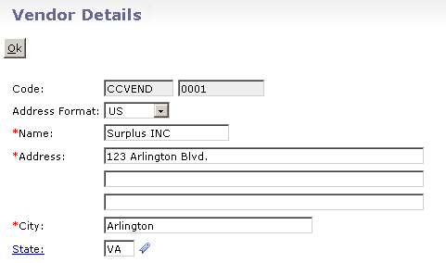
Header Tab - CCVEND
If you cannot find a vendor then enter CCVEND into the text box next to Code
Click the More button
Enter in address information and click Ok
Do NOT use CCVEND for
convenience checks, only use
with Purchase Cards.
Notes:
Pegasys sends an email to solicit for a receipt, so put the receiver of the goods in the *Email field

Slide 10
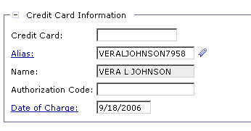
Header Tab - Purchase Card Information
Required: Enter the purchase card Alias. If you don’t know it, you can search for it by clicking the Alias hyperlink.
Required: Enter the Date of Charge; if left blank it will default to today’s date.
Enter the 6 digit Authorization Code, from receipt. (Optional)
Notes:
This is OPTIONAL but you can add the contracting vendor by Suggested Vendor

Slide 11
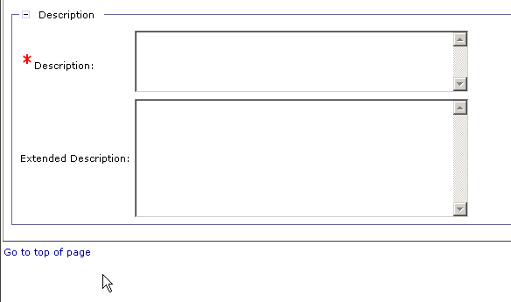
Header Tab - Description
Enter a Description.
  Tip – Save Often – after completing each tab or before stepping away from your desk you should SAVE your form.
Notes:
Code is the TIN # (tax identification number)
Use wild card because Pegasys looks for an exact match Example: Inc does not equal Inc.
If the vendor isn’t in Pegasys then you can email the finance centers in FW and KC to get the vendor put in. Takes less then 24hrs

Slide 12
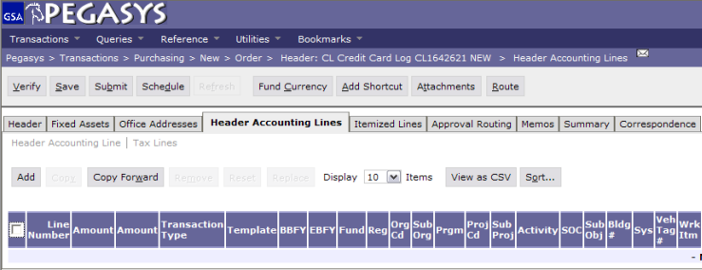
Header Accounting Lines Tab
To add an accounting line:
- Click on the Header Accounting Lines tab.
- Click on the Add button.

Slide 13
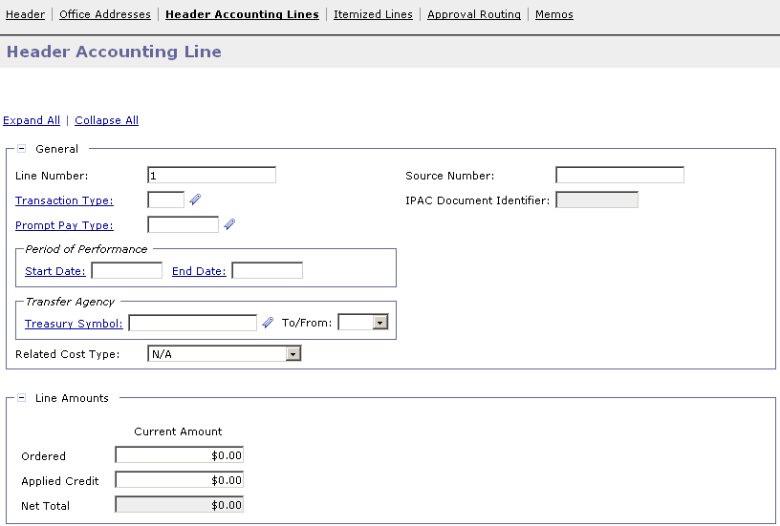
Header Accounting Lines Tab
Enter the amount of the transaction in the Ordered field.

Slide 14
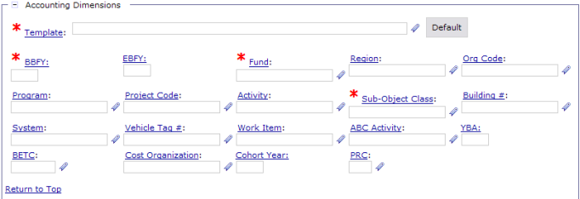
Header Accounting Lines Tab
Enter accounting template and other required data fields
  Tip – Favorites ( ) – Use the Favorites icon to save and select frequently used reference data.

Slide 15
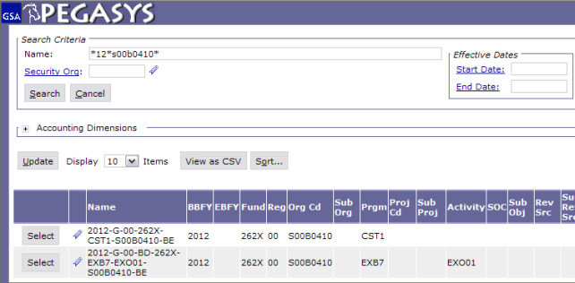
Header Accounting Lines Tab
Enter criteria separated by the wildcard (*) and click Search.
Highlight the desired template and click Select.

Slide 16
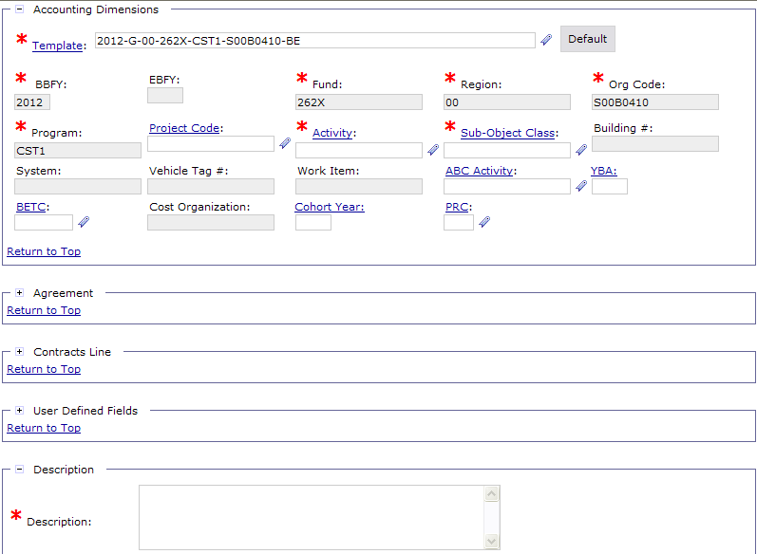
Header Accounting Lines Tab
Enter in a SOC and Activity.
Note: Your accounting classification may require other data elements to be entered, such as BLDG Number, RWA, Work Item, Vehicle Tag #, Project Code, etc.
Tip – SAVE OFTEN – Saving often makes sure you will not have to re-key the information later

Slide 17
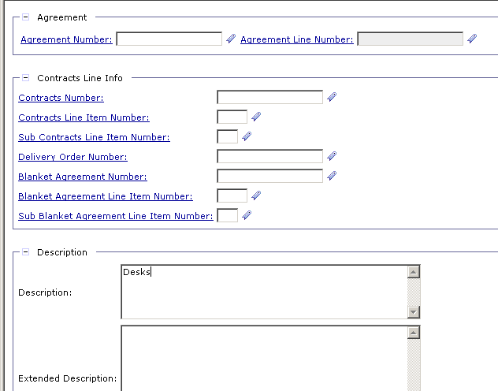
Header Accounting Lines Tab
OPTIONAL
-When entering RWA’s use the Agreement Field. For Agreement Number drop Alpha
-Enter “1” in the Agreement Line Number field.
Save Often
Enter Description
Notes:
Agreement Number is the RWA number (PBS ONLY)
Drop alpha and add the number
If you have more than one accounting lines use the Description field to distinguish between them.

Slide 18
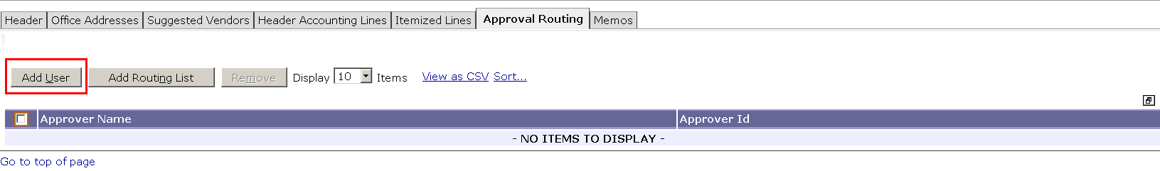
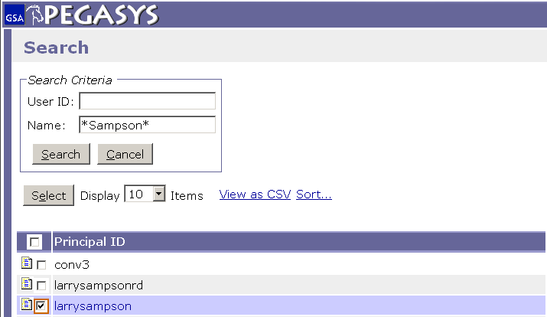
Purchase Requests - Approval Routing (Add User)
-Click Approval Routing
-Click Add User
-Enter Approver’s name
-Highlight Name
-Click Select
The * is a wild card for searching
Notes:
Agreement Number is the RWA number (PBS ONLY)
Drop alpha and add the number
If you have more than one accounting lines use the Description field to distinguish between them.

Slide 19
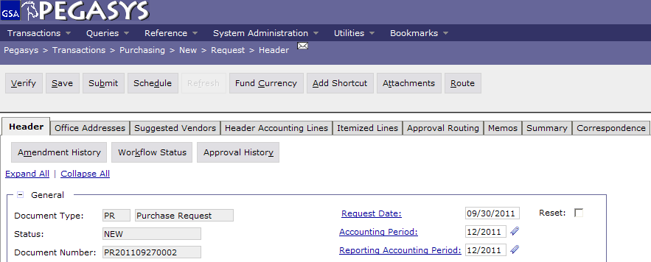
Save, Verify, Submit
  To finish the Purchase Request:
  - Save the form
  - Verify and correct any errors
  - Submit the document for approvals and processing

Slide 20
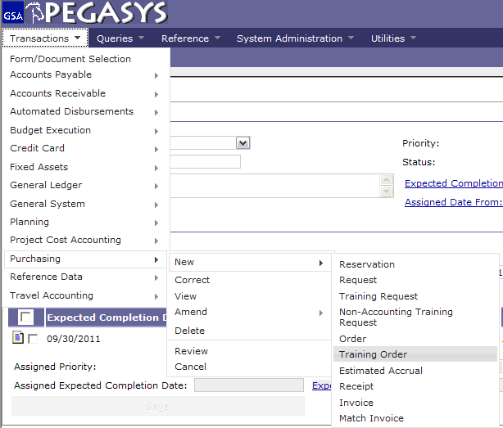
Creating a Purchase Card Training Log - CT
Choose:
Transactions
Purchasing
New
Training Order
Notes:
DEMO:
Using the new Form from the previous example, on the Header Accounting Lines tab
Click the Add button to add a line
Click the Favorites icon for the Template field
Click the Search Link
Enter CC-192X-PG61-P032C300* in the Code Field
Click the Search button
Click Favorites icon to add to Favorites
Click the Cancel button
Back on the Form, display the newly created Favorite by clicking the Favorite icon for the Template field

Slide 21
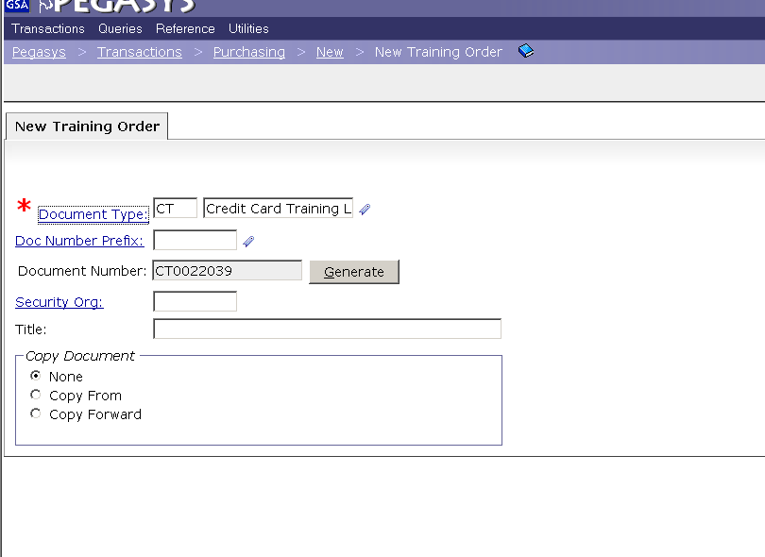
Creating a Purchase Card Training Log – CT
Enter CT (Credit Card Log) as the Document Type then press the tab key.
Click the Generate button.
Click the Finish button.
Notes:
If the approver has a backup Pegasys will send to both. If one approves it, it will show up to the other as Acquired and won’t be accessible.

Slide 22
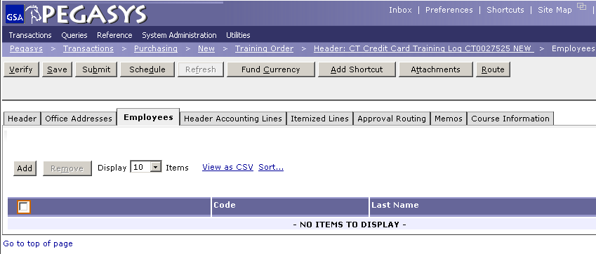
CT - Employees Tab
Choose the Employees tab.
Click on Add to add new students

Slide 23
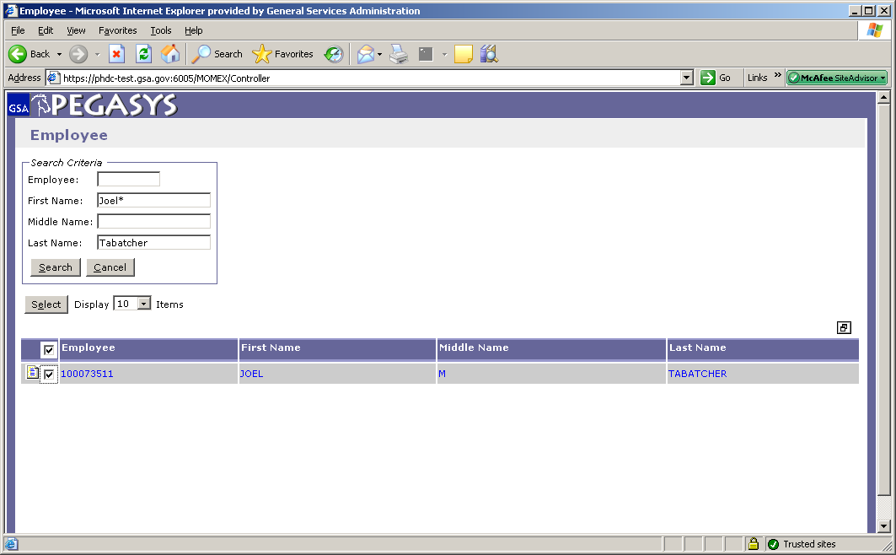
CT - Employees Tab
Type in employees name with wild card.
Highlight Employee
Click Select
Note: If employee is not in the system, contact the OCFO Service Desk.
Notes:
Receipt based on goods that are physically here, or through email
Can do Receipt before Pegasys prompts you. If you get the goods and they are good then do the receipt!

Slide 24
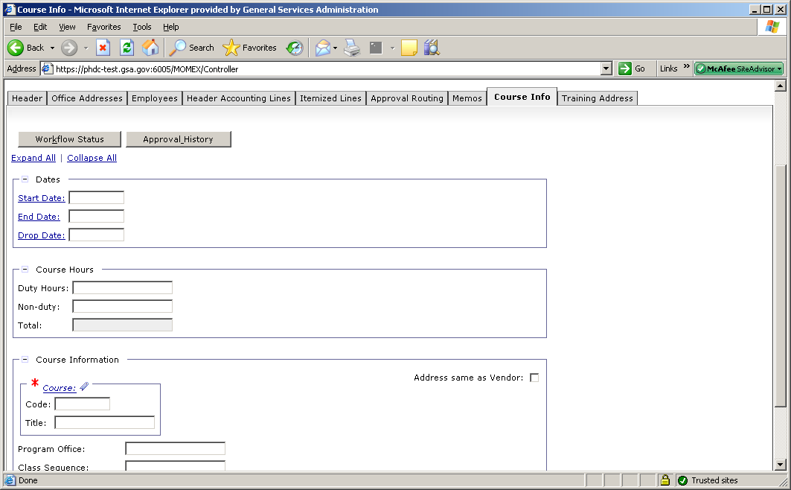
CT - Course Information Tab
click the Course Info tab.
Enter the Start Date and End Date. (Optional)
Enter in the Course Code and Title.
For more information, go to http://pegasys.gsa.gov/ref/howto.htm

Slide 25
Convenience Checks
Convenience checks require:
CL/CT for actual transaction
  Must equal amount of check
  Vendor Code – Merchant
Create CL for check fee
  Title = Check Fee
  Amount = Purch. Amt. x 2.1% + $1(Srvc. Charge)
  Vendor/Address = 460358360/00021(Citibank)
  Accounting Template & Activity same as used in #1
  SOC = J01

Slide 26
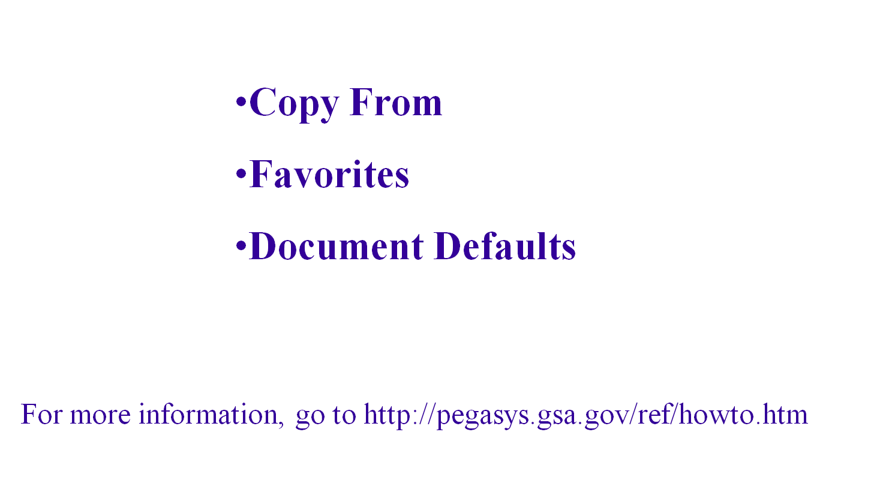
Features – Copy From

Slide 27

Goals of Information Security
Confidentiality
  Data must be protected against unauthorized disclosure
Integrity
  Systems must not permit processes or data to be changed without authorization
Availability
  Systems must be functional and operational
Confidentiality
Integrity
Availability
Notes:
Please take a few moments and review the remaining slides on Information Security

Slide 28
Why is Information Security Important?
Must be in compliance with regulatory requirements such as OMB Circular A-130, Computer Security Act, FISMA and GSA IT security policies
Protects GSA information resources from potential abuse and misuse
Follows sound business practices

Slide 29
User Responsibility
Responsible for adherence to GSA information security policy
Protect Pegasys login ID and password
  Do not allow others to use your login ID / password
  Do not write it down
Log out whenever you are not using Pegasys
Protect sensitive information
  Shred reports containing sensitive information
Report security incidents
  Refer to OCFO Incident Handling Procedures for further guidance
  Report security incidents to your supervisor

Slide 30

Keys to Incident Prevention
Awareness - be aware of the value of the assets you are using to do your job and the nature of associated threats vulnerabilities and suspicious activities
Compliance - comply with established safeguards, policies, and processes
Common Sense - if something appears to be off, it generally is

Slide 31
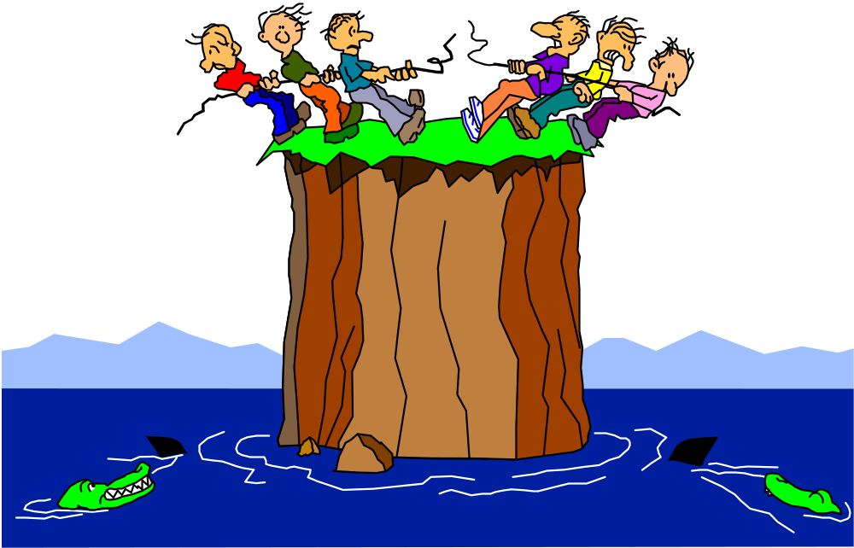
Remember ...
Security is a PEOPLE issue,
not only a TECHNICAL one!

